Slide 1
Lab 7
SQL II - Create your own database model

Slide 2
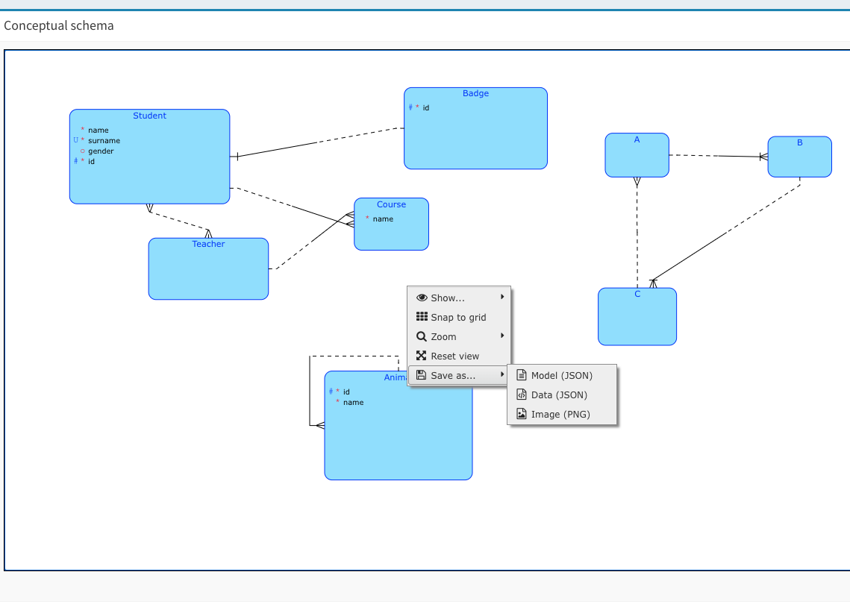
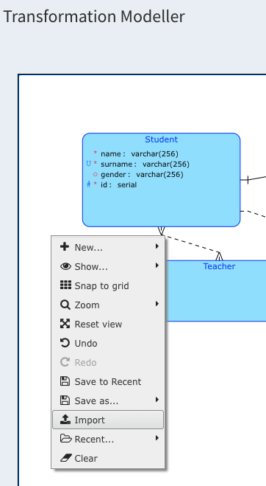
How prepare Create (DDL) Script
The simplest way is to use a conceptual model
Save it as JSON using the right mouse button
Open the Transformation Modeller again using the Import from JSON function
And have the DDL generated
Never use reserved words like “User”, “Order”,“From”, “Select”, “Where”, “To” in entity names. If you need them, use e.g. MyUser, MyFrom etc.
Never create long names for primary keys. Always use only short abbreviations (Id, MyID, TID, etc). Long names cause problems with the database limit for the length of the keys.

Slide 3
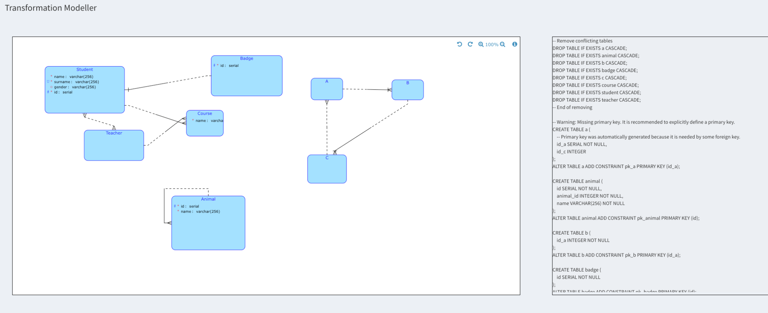
Create script (DDL) in Transformation Modeller
Use DDL

Slide 4
Now you have to connect your own PostgreSQL database.
It is absolutely NECESSARY to make this connection.
It must have full permissions (must not be read-only... checkbox must not be checked)
Follow instruction on the following slide!

Slide 5
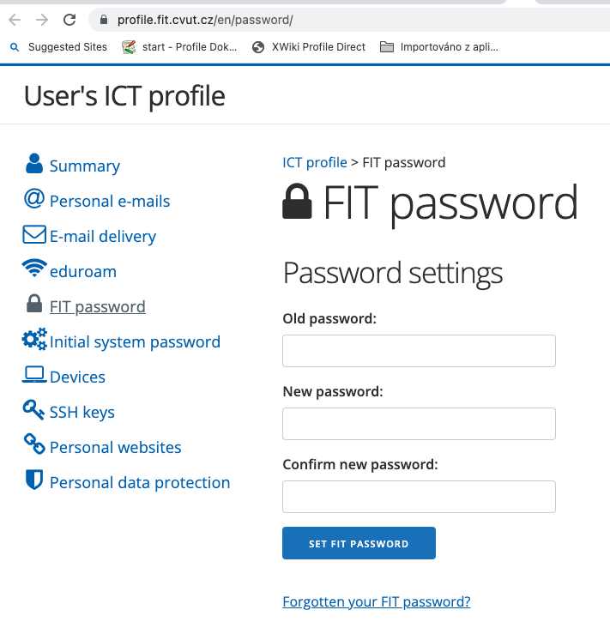
SQL Server connection
Go to DBS Portal
In the left menu "+ New connection"
Connection name: Any (we recommend your username, etc.)
Database type: PostgreSQL
Hostname: pg.dbs.fit.cvut.cz
Port: Do not change (but it is port 5432)
Database name: your_username (for. example pavlijo5)
Username: your_username(for. example pavlijo5)
Password: FIT password -
It must be created or changed here (it’s required for authentication into database)
Password again: Retry the same password
We recommend setting it as the default connection
Perform a connection test
Make a connection

Slide 6
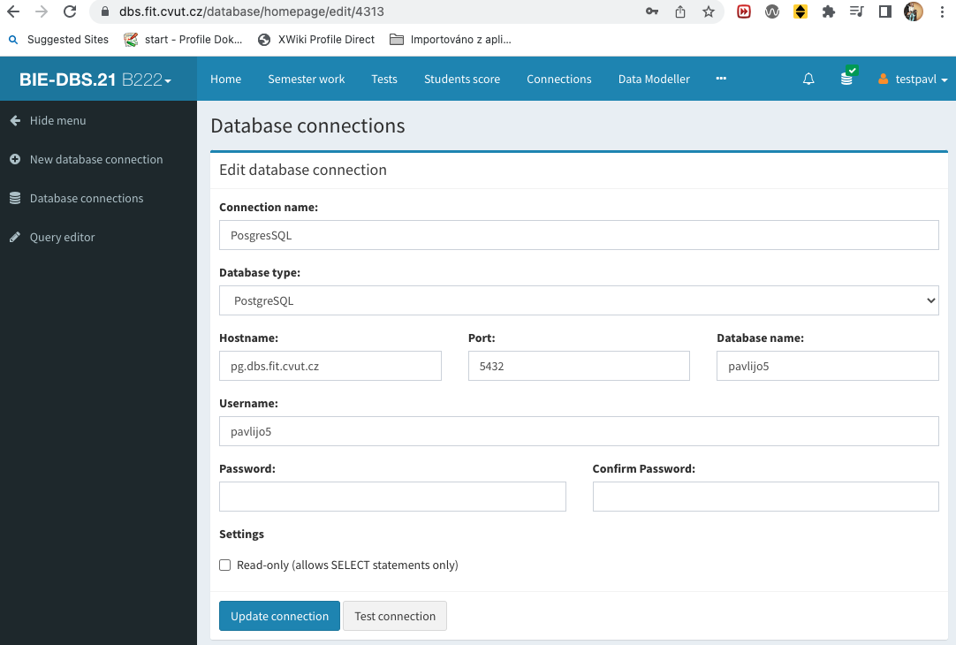
SQL server connection
Leave empty (DON’T SELECT IT)

Slide 7
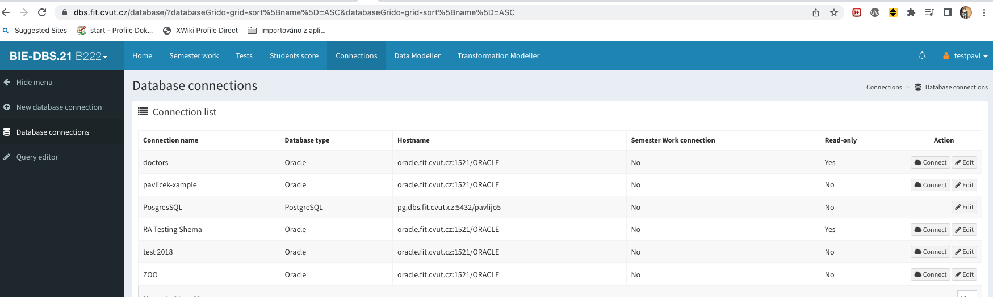
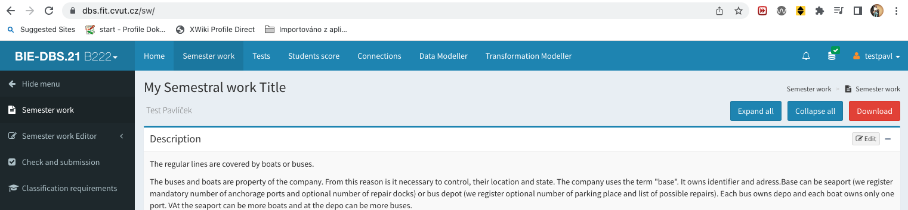
DBS Portal connection
That you are connected you can see here

Slide 8
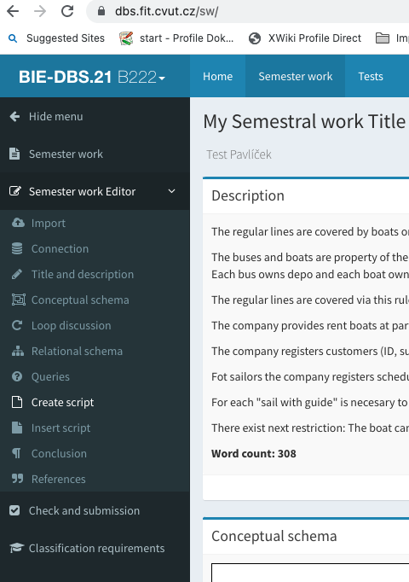
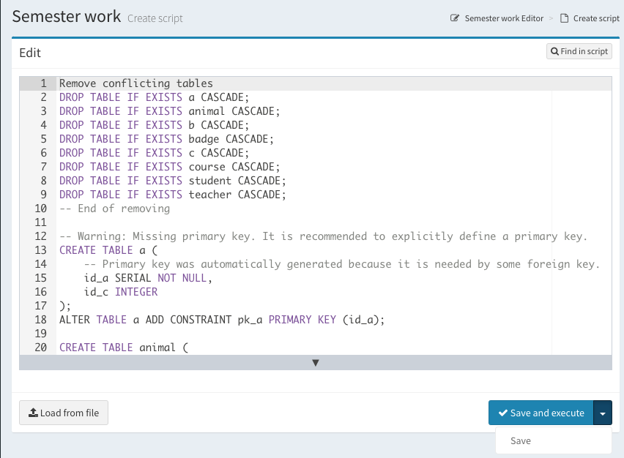
Put your Create script into the DBS
Go to the Semester work editor, Create script section
Insert the generated Create script from Transformation modeler into Create script section and save it.

Slide 9
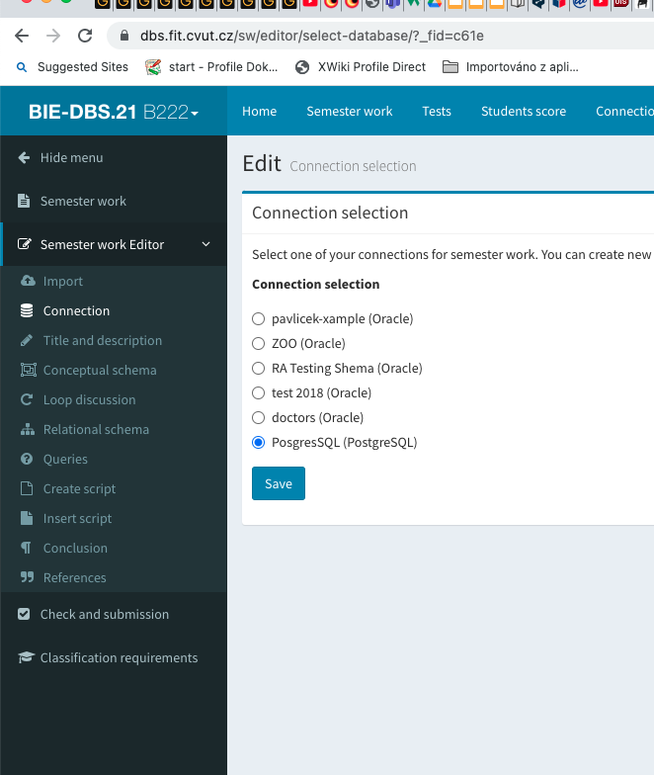
What happens after you let create script execute?
Check, if your settings is correctly set at the section Semester Work -> Queries->
The system will try to connect to the set connection.
If there is a different connection (e.g. Doctor), it will report an error
If it is set as read-only, it will report an error
If everything is OK, the system reports success

Slide 10
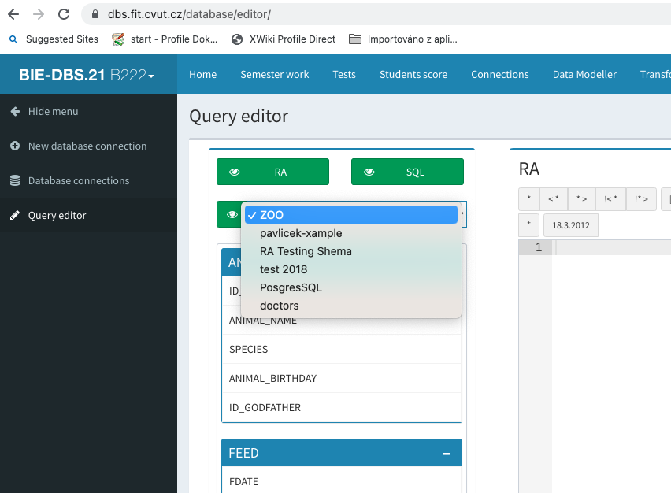
How to prepare Insert Script
If you have already created a database (or you already have tables in the schema) you can look at it using the Query editor. You don't have data in it.
You can load them using the SQL command window in this editor via commands:
INSERT INTO table_name (column1, column2, column3, ...) VALUES (value1, value2, value3, ...);
This is not very comfortable, it is better to connect to the database using one of the SW clients
INSERT INTO Customers (CustomerName, ContactName, Address, City, PostalCode, Country)
VALUES ('Cardinal', 'Tom B. Erichsen', 'Skagen 21', 'Stavanger', '4006', 'Norway');

Slide 11
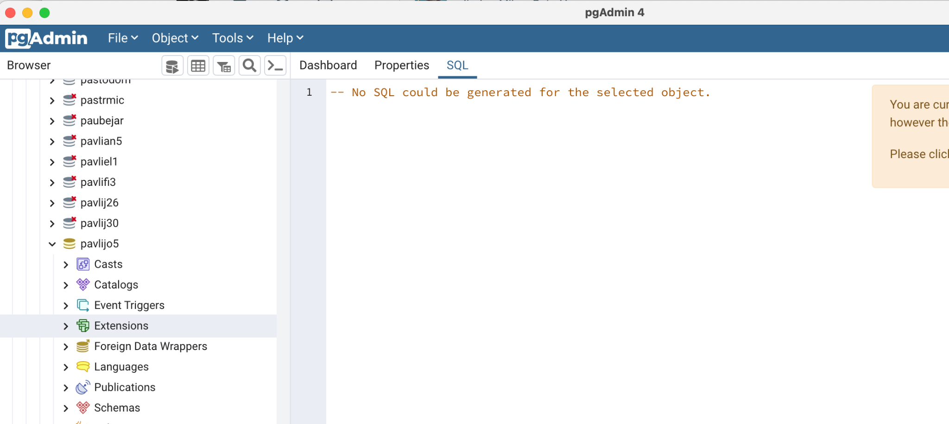
Download database SW clients
Clients
PgAdmin download here (version 4 or higher)
JetBrains datagrip download here
Install you favourite variant and join that (via your credential used for DBS portal) with your database schema

Slide 12
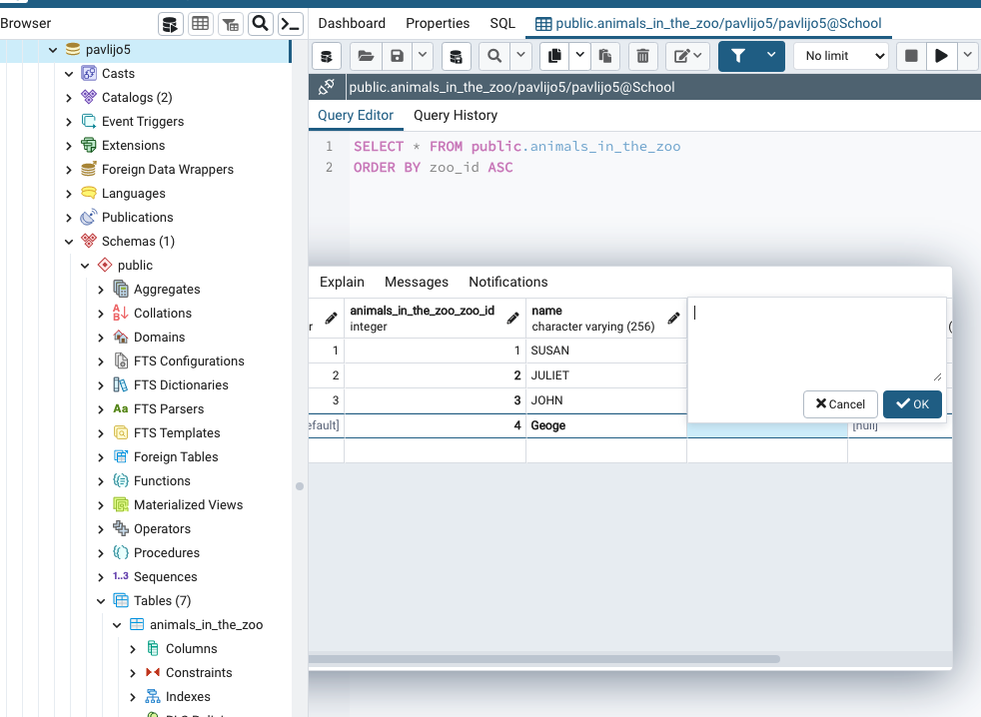
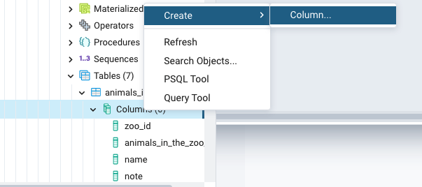
PgAdmin example
Here you can conveniently change data, add rows, change tables, column names etc:
Add/update/delete rows
Add/update/delete columns

Slide 13
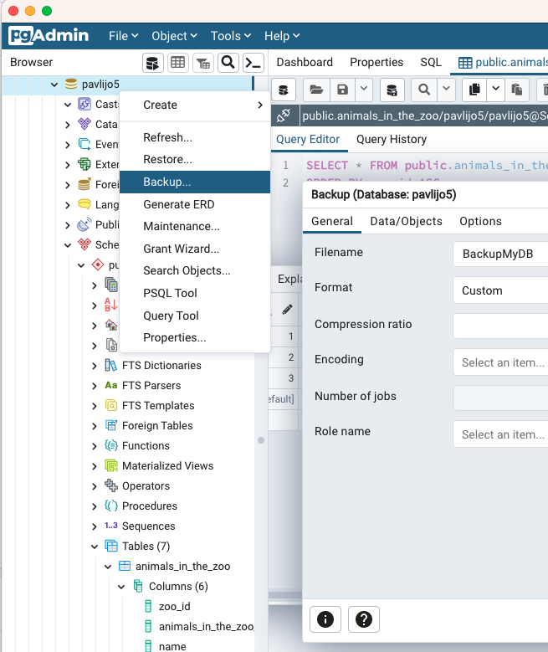
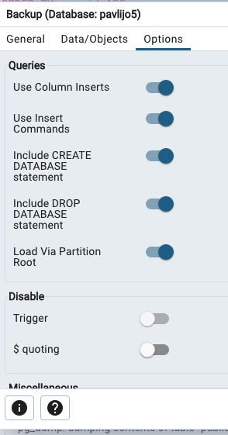
Saving modifications
If you add and change data in the database, or modify tables according to your needs, then eventually you must get a valid database model and its data. You will need to get Create and Insert script and modified it in the Semester work editor.
This can be obtained using the database backup - Backup
You have to go to the root of your project on the database schema and right-click on the Backup menu. From the Backup panel select ALL Data/Objects and in Options set all queries.
Save it as UTF8.

Slide 14
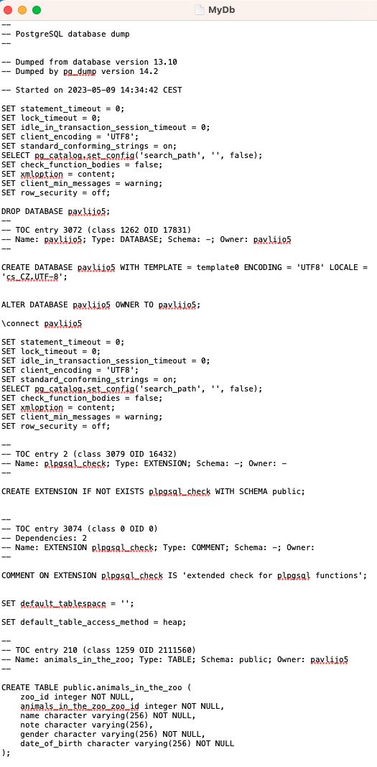
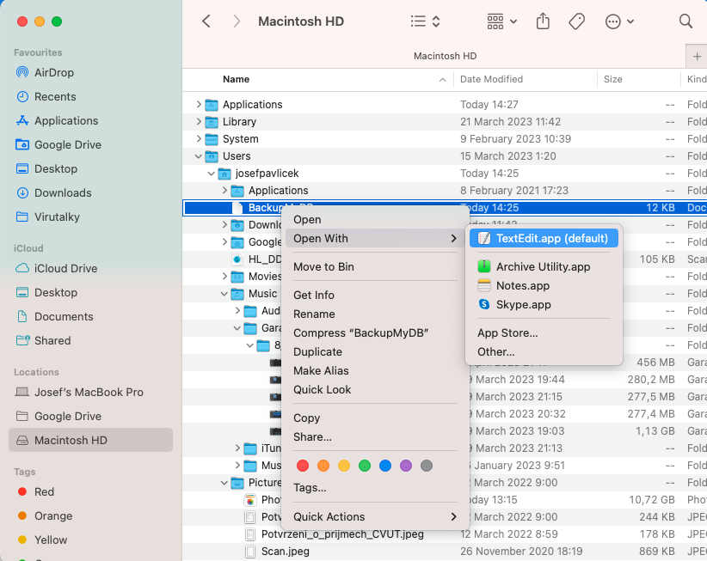
Saving modifications - Backup
It depends on the SW client you are using where the backup is stored. In the case of PgAdmin my version is stored at "/Users/josefpavlicek/BackupMyDB”

Slide 15
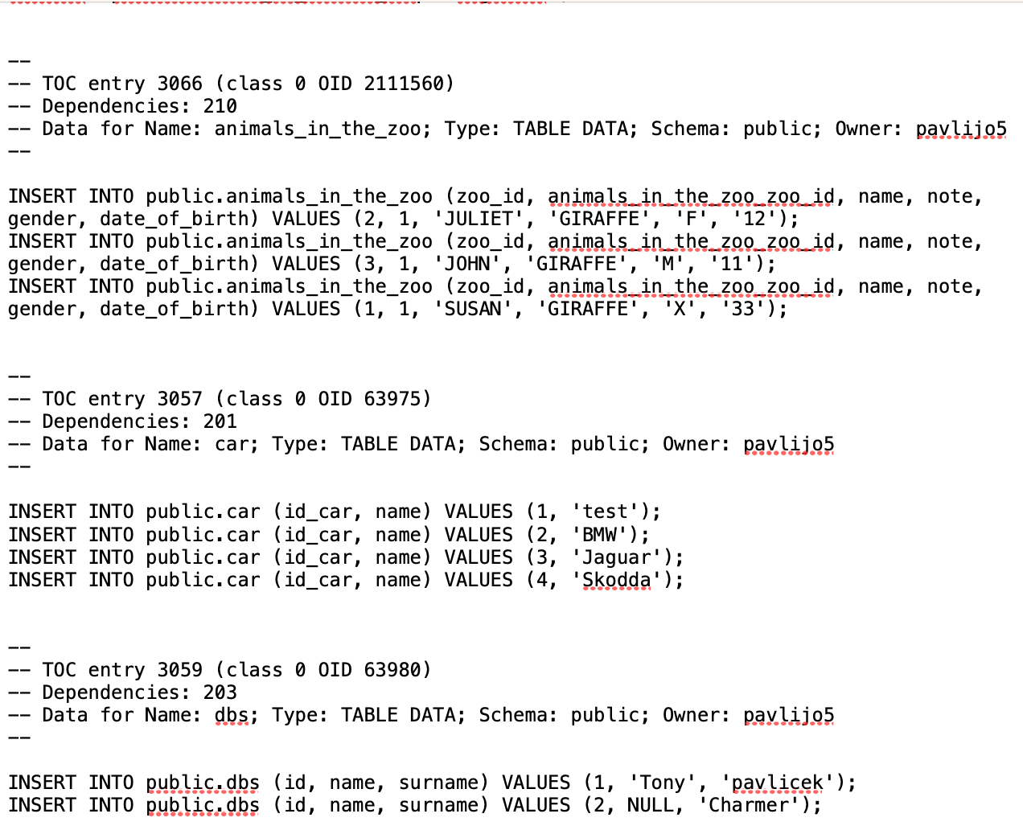
Now you have to modified the Create and Insert script
You will need to split the backup into to scripts:
Create … it starts with CREATE TABLE xy
Insert … it starts with Insert INTO…xy
Don’t forget to remove “public.” from the Create and Insert commands.
Now you can put it into the DBS portal, Semestral work.

